Slide 1
RESEARCH BACKGROUND
Neuroevolution of Self-Interpretable Agents
University of Science and Technology of China

Slide 2
CONTENTS
01
研究问题
02
背景知识
03
研究内容
04
结论

Slide 3
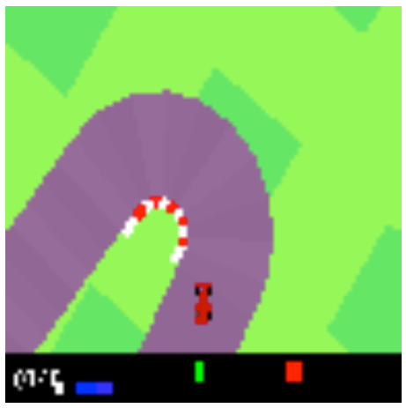
1
研究问题
RESEARCH BACKGROUND
RESEARCH BACKGROUND
Reinforcement learning:
Reinforcement learning (RL) is an area of machine learning concerned with how software agents ought to take actions in an environment in order to maximize the notion of cumulative reward.

Slide 4
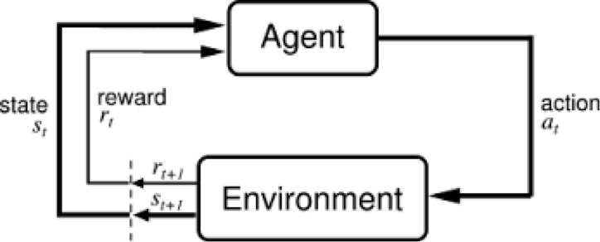
2
背景知识
Direct encoding methods: Most current methods used to train neural network aim to solve for the value of each individual weight parameter of a given neural network.
Notes:
强化学习领域，大家都着眼于找到一个比较好的网络参数，参数太多，学习难度比较大
如果用少量参数决定所有参数的变化，可以降低学习难度，但是参数空间不完整了,有可能找不到合适的网络
本文用一种新的思路，注意力机制，让网络只关注图像的重要部分

Slide 5
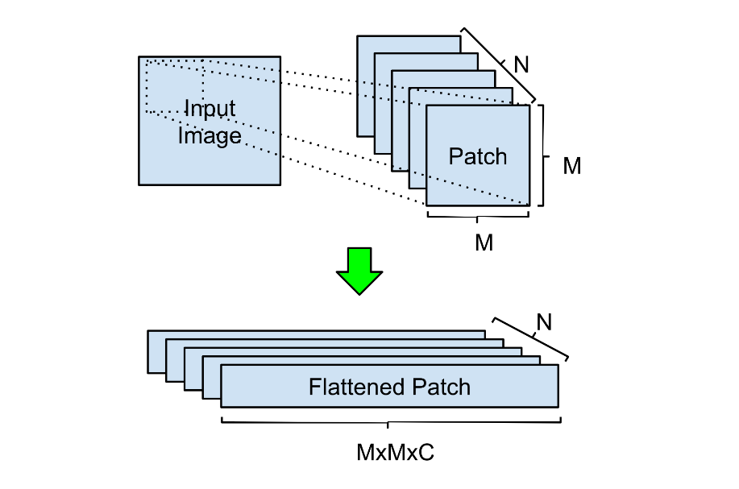


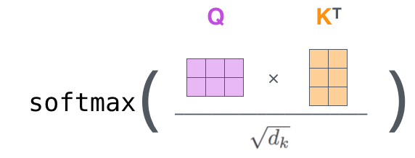

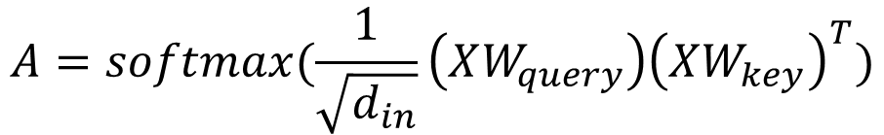
3
研究内容
RESEARCH BACKGROUND
RESEARCH CONTENT
Self-Attention:
$$A=softmax(\frac{1}{\sqrt{d_{in}}}\left(XW_{query}\right){\left(XW_{key}\right)}^{T})$$
$$\sqrt{d_{in}}$$
Window size (M) = 7
Stride = 4
d=4
Notes:
模仿人类，只关注部分信息，使用patch减少计算，query值和key值都是由原始输入得到
D比较小，表示高级特征, Query 可以视为原特征向量，而 Key 和 Value 可以视为目标。一般的注意力机制可解释为计算 Query 和 Key 之间的相似性，并利用这种相似性确定 Query 和 Value 之间的注意力关系。Query去和key空间所有值做匹配，计算匹配度

Slide 6
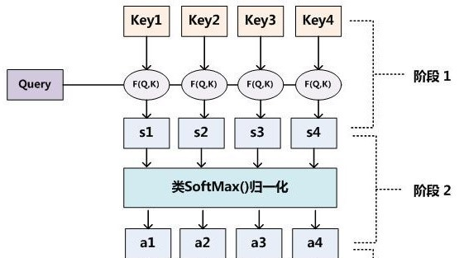

3
研究内容
RESEARCH BACKGROUND
framework
$$\sqrt{d_{in}}$$

Slide 7
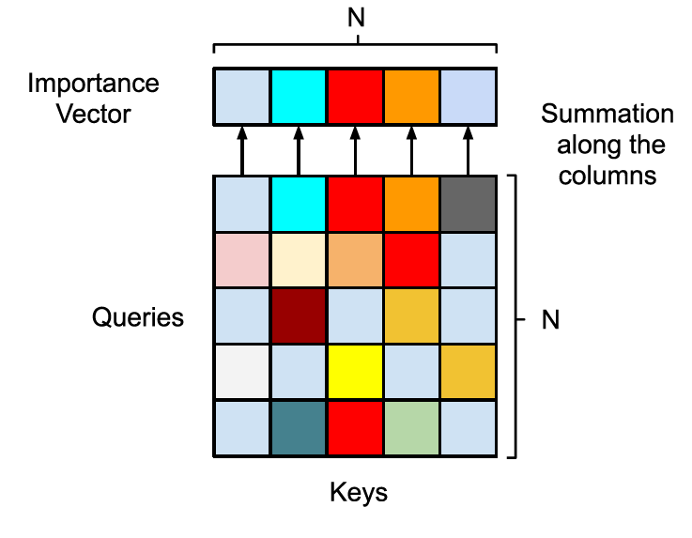
3
研究内容
RESEARCH BACKGROUND
framework
Importance Voting via Self-Attention

Slide 8
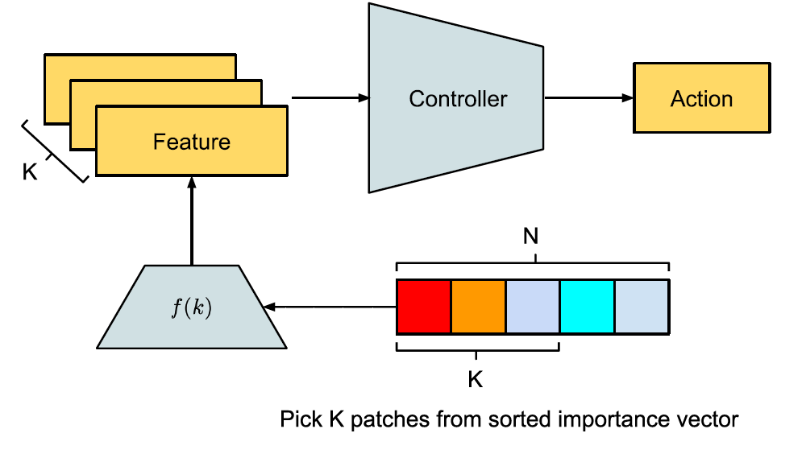
3
研究内容
RESEARCH BACKGROUND
framework
Patch Selection and Feature Retrieval
LSTM
left/right、 acceleration 、 brake
K=10
Notes:
本文F(x)直接输出前k个patch中心点坐标，当然也可以用一个神经网络

Slide 9
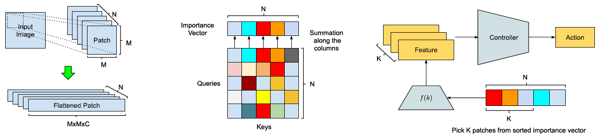
3
研究内容
RESEARCH BACKGROUND
framework
Notes:
整个过程

Slide 10
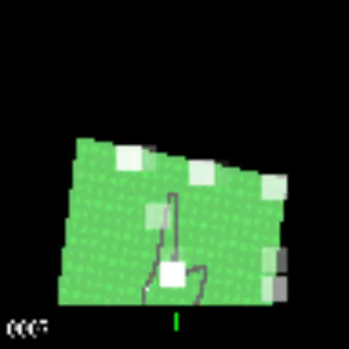
3
研究内容
RESEARCH BACKGROUND
framework

Slide 11
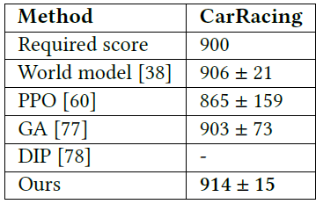
3
研究内容
RESEARCH BACKGROUND
framework
#Params
4,733,485
445,955
4,733,485
4,733,485
3,667
Notes:
参数少，得分高

Slide 12
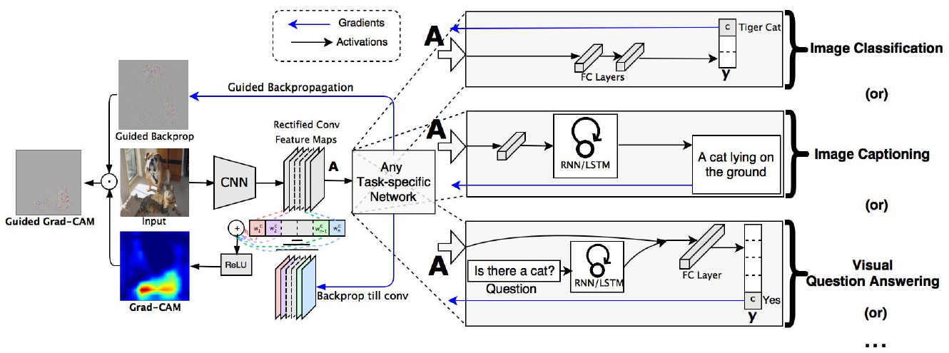
3
研究内容
RESEARCH BACKGROUND
comment
Advantages:
Agent achieves competitive results with significantly fewer parameters by self-attention.
This agent is easily interpretable in pixel space.
Self-attention is input-dependent. Our agent attends to only task-critical visual hints, they are able to generalize to environments where task irrelevant elements are modified while conventional methods fail.

Slide 13
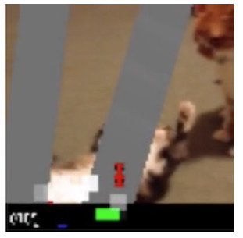
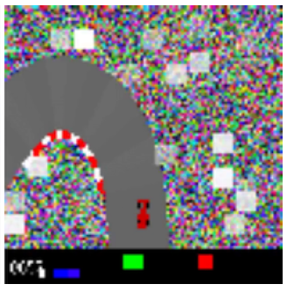
3
研究内容
RESEARCH BACKGROUND
framework
Disadvantages:
Notes:
性能下降

Slide 14
RESEARCH BACKGROUND
谢谢！
TNANKS FOR LISTENING
Notes:
我的报告到此结束，谢谢各位老师。

